Slide 1


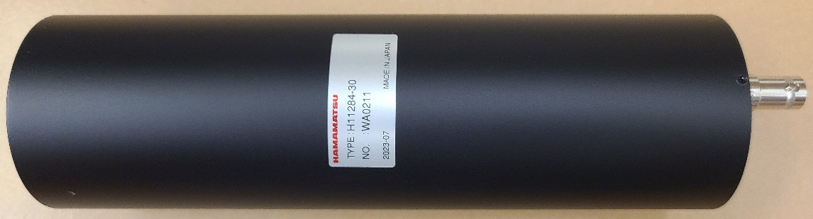
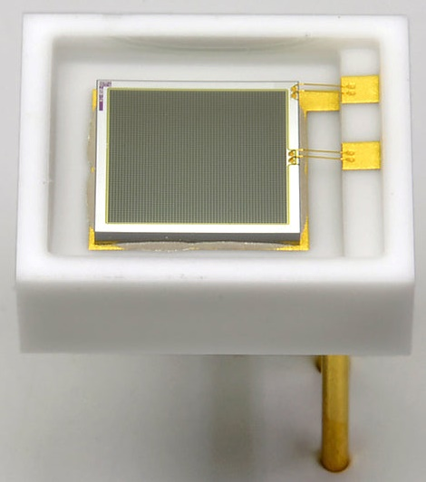
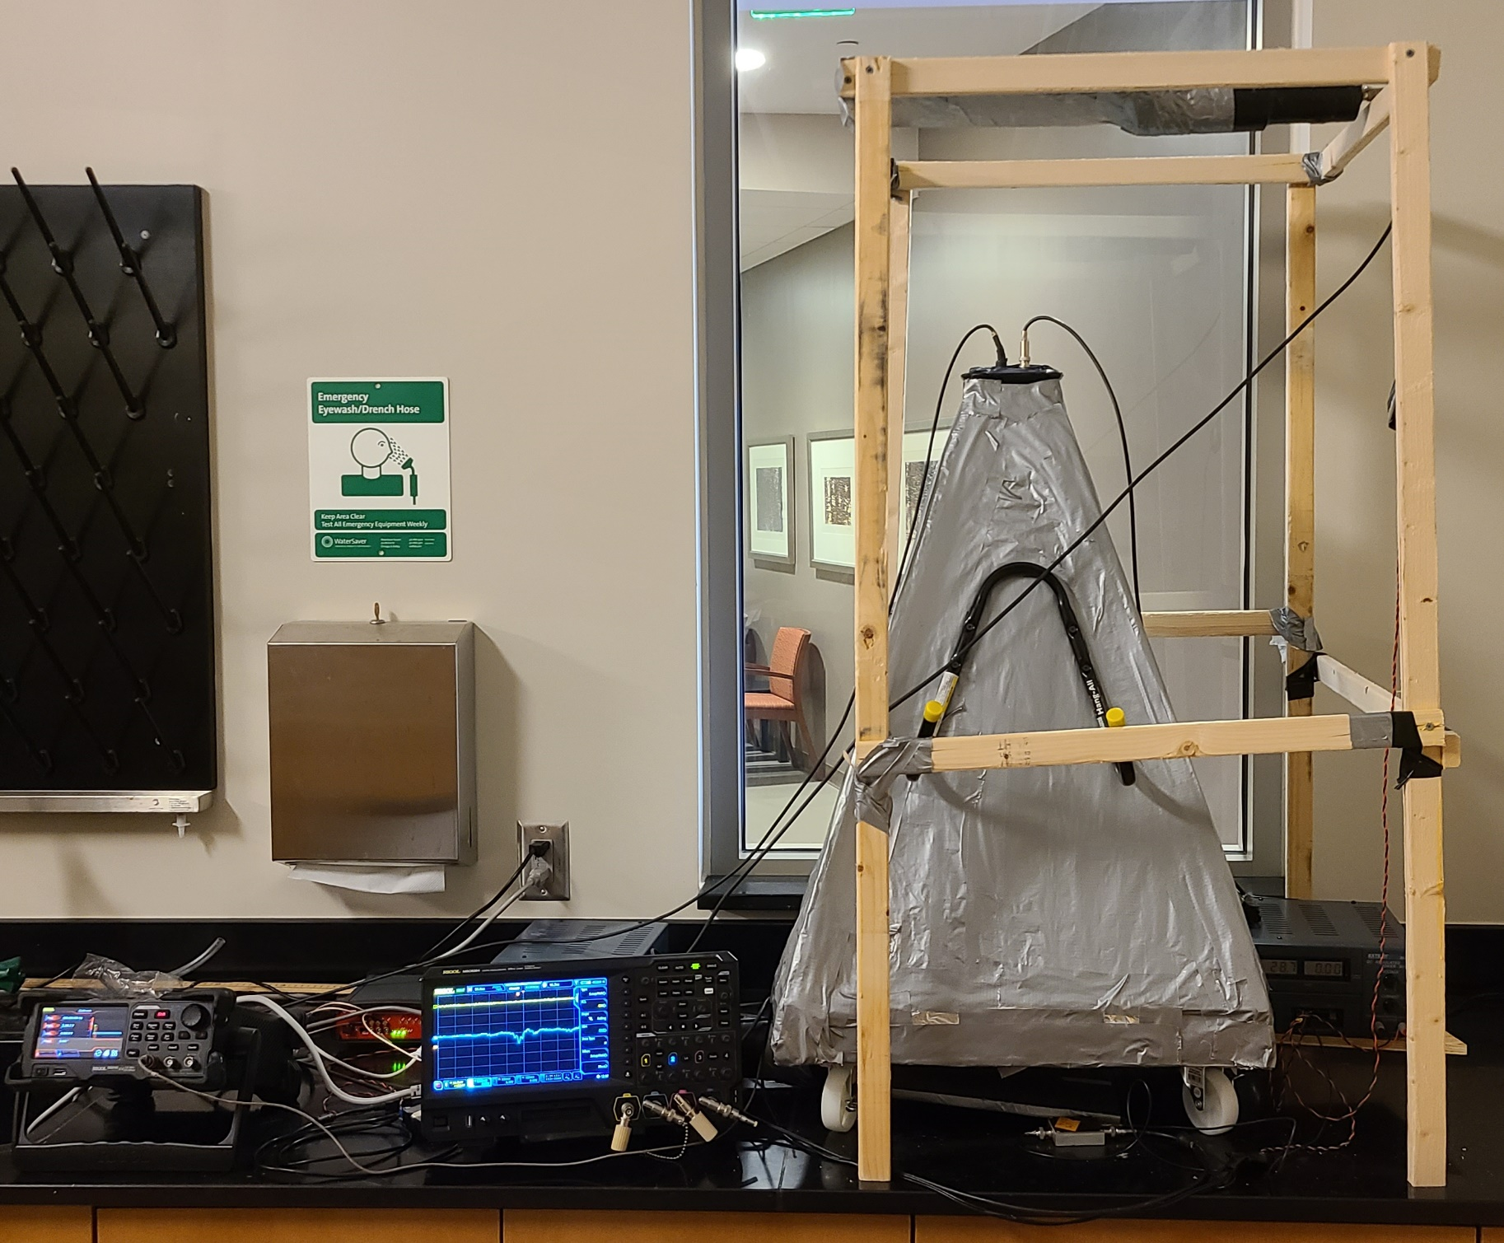
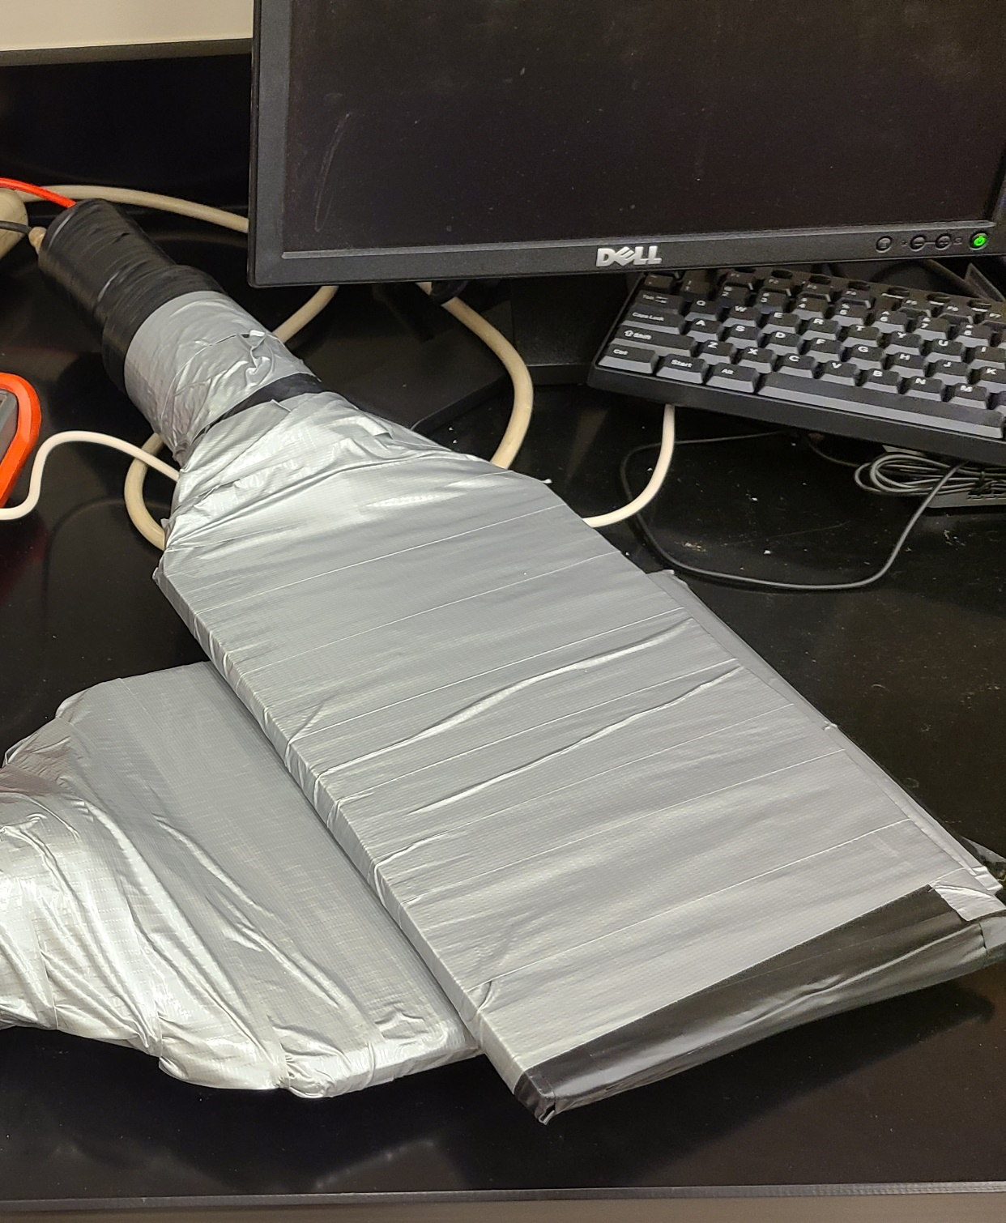
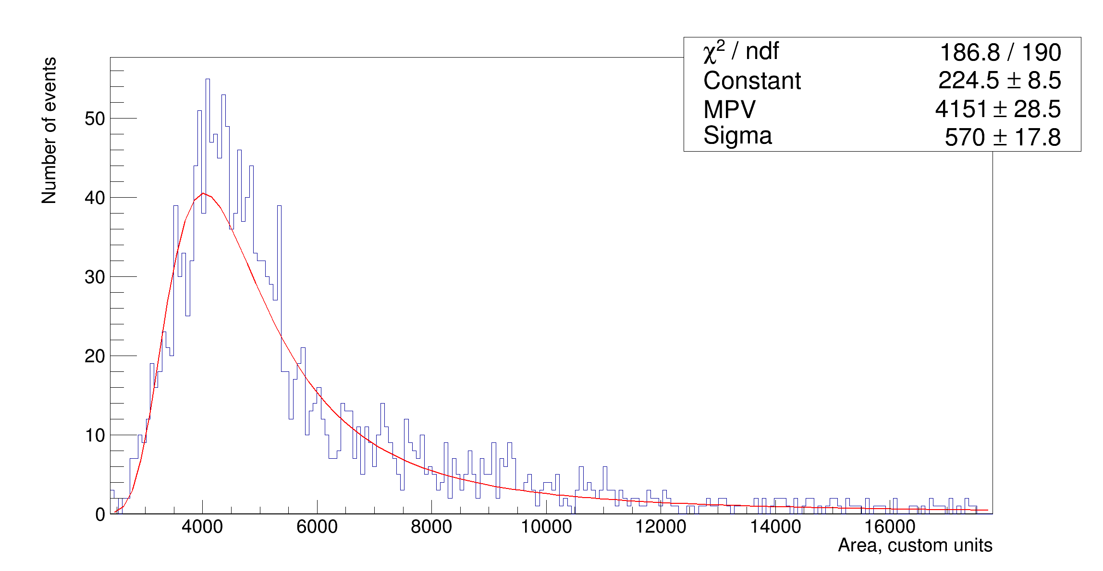
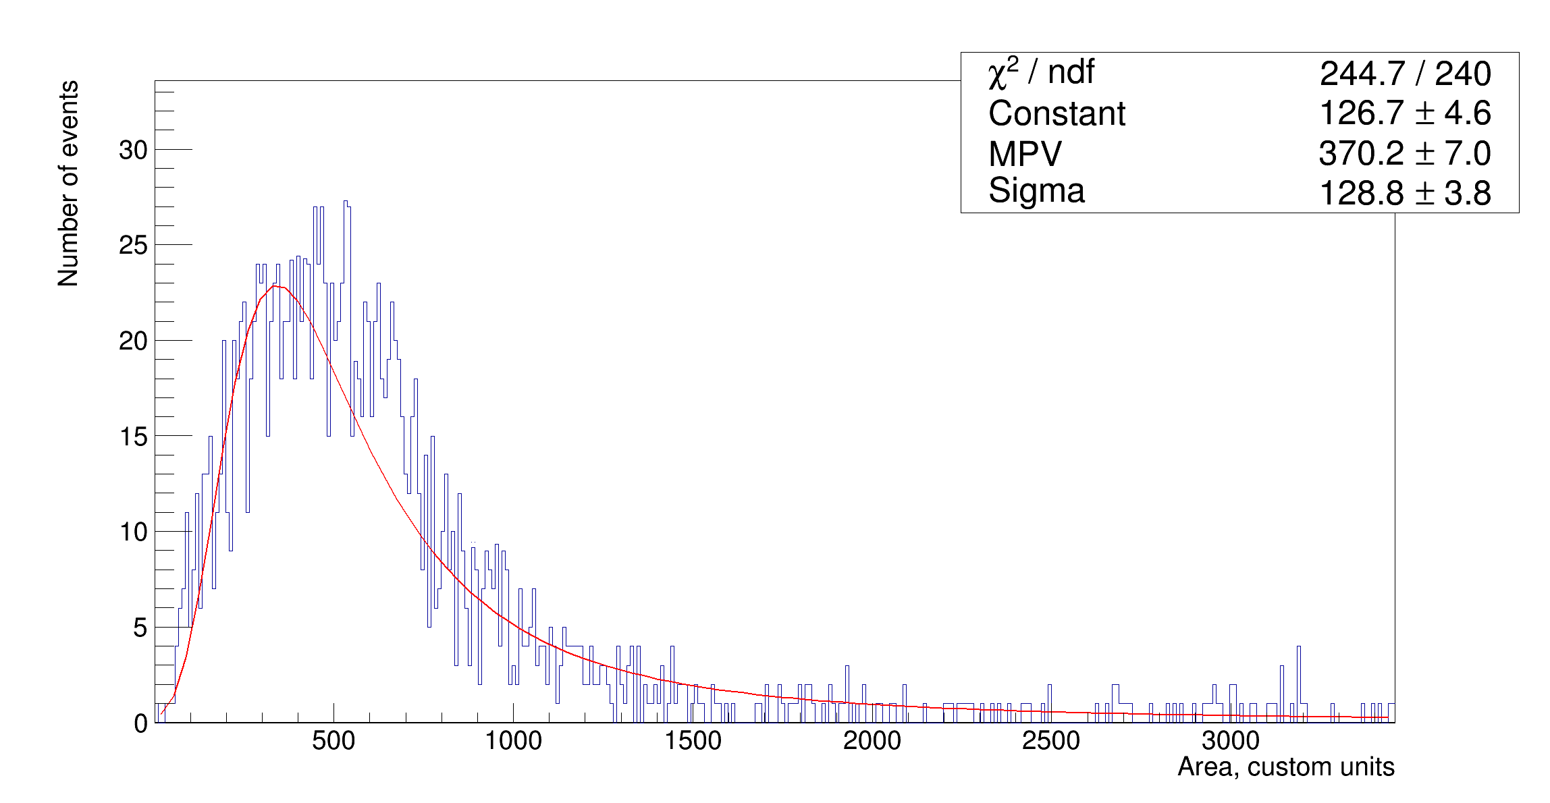
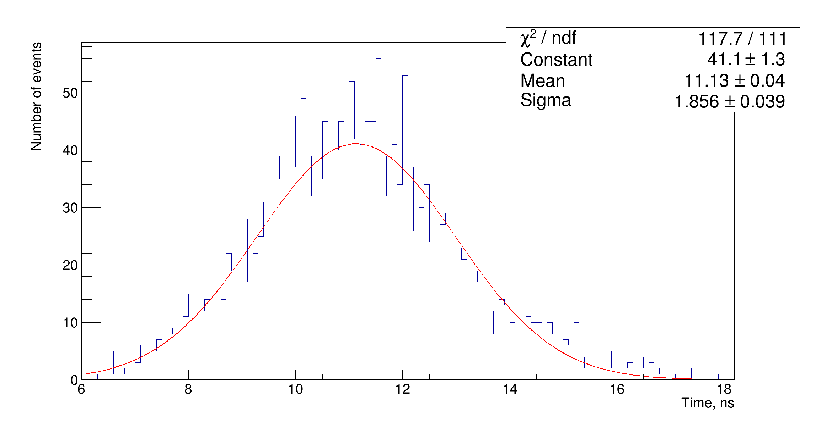
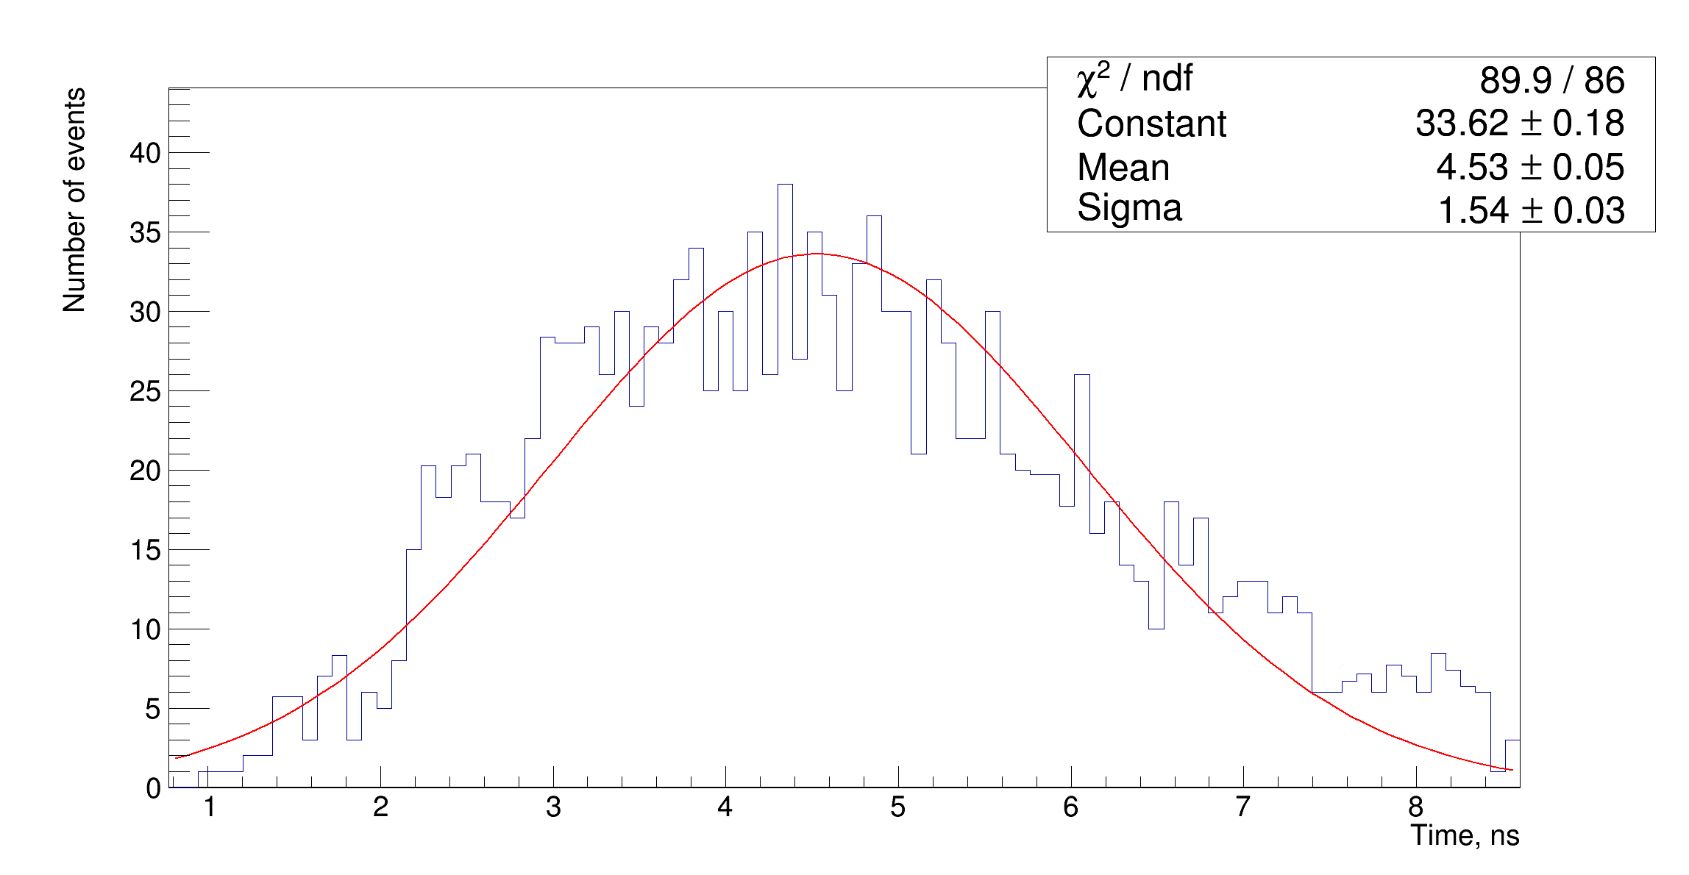
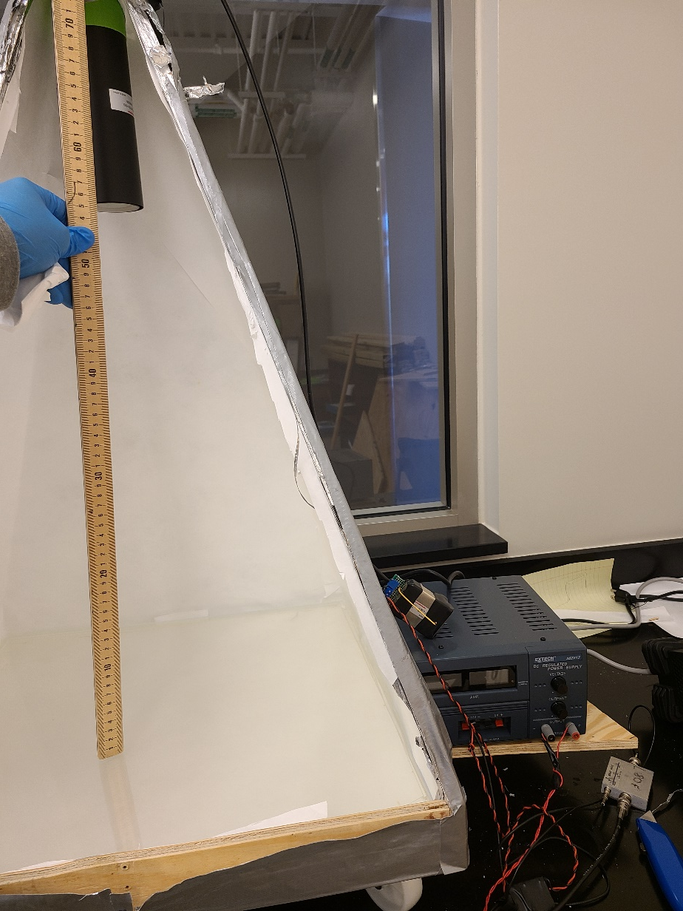
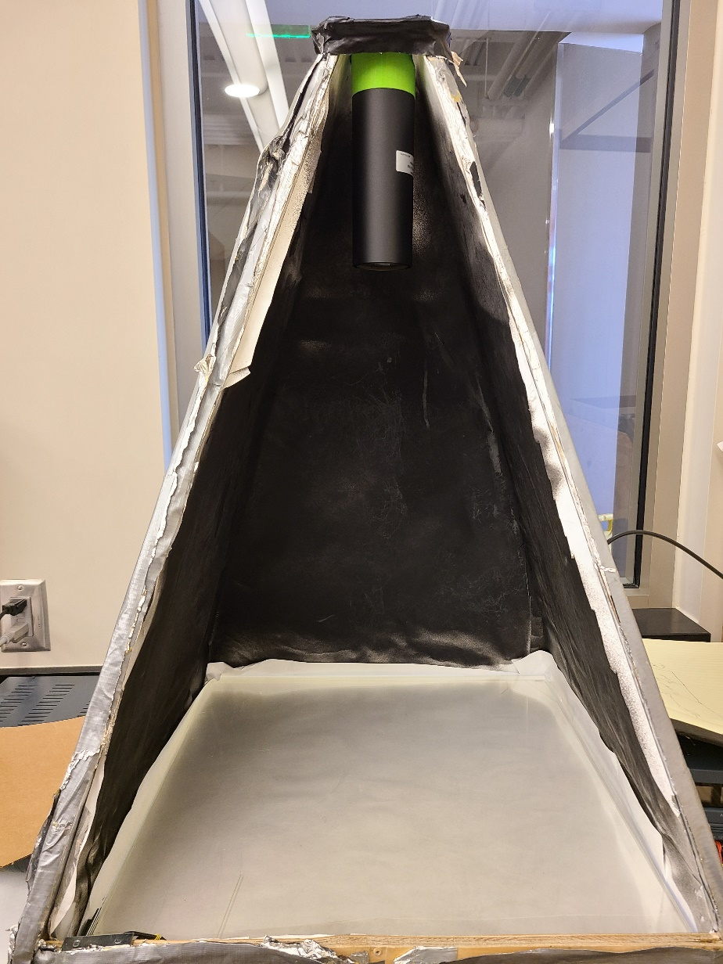
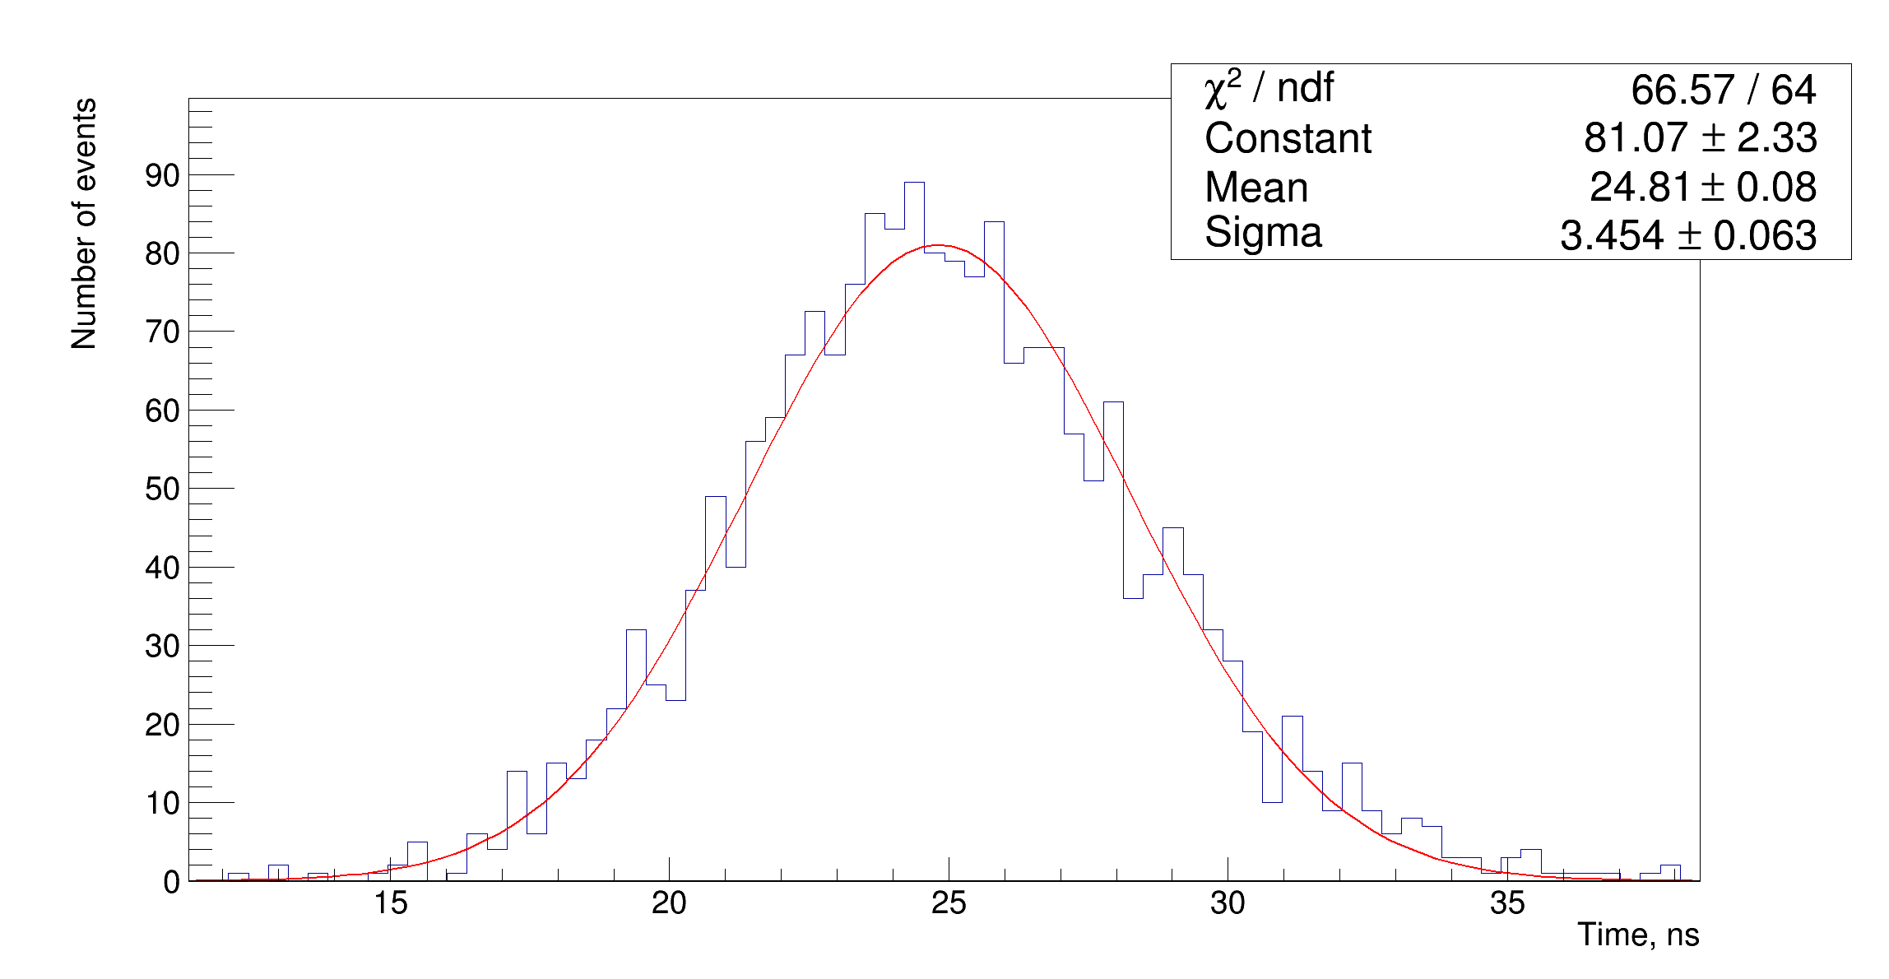
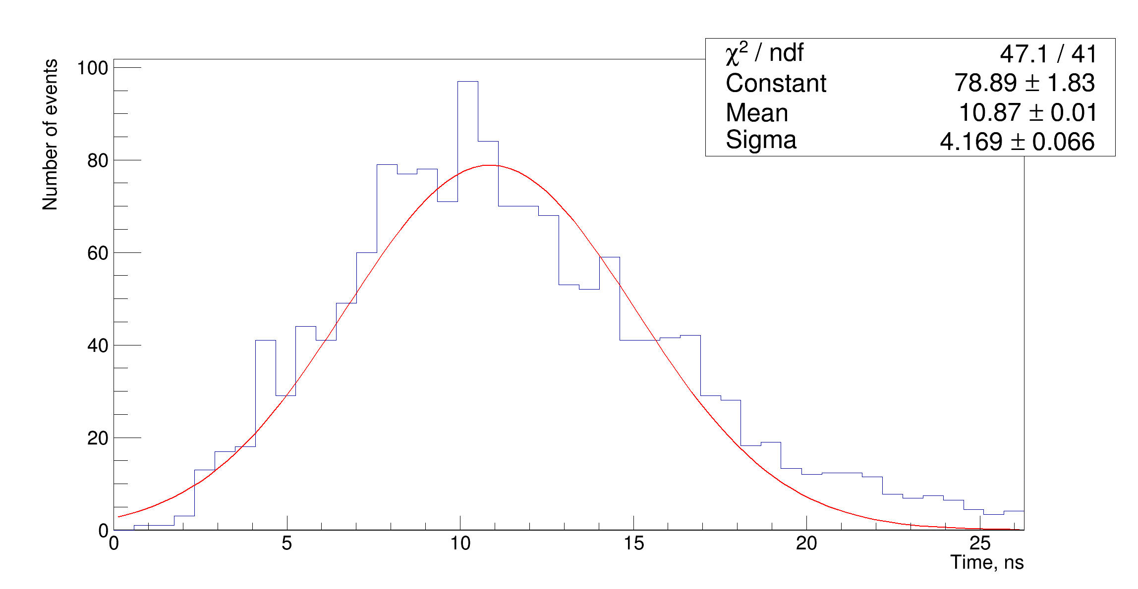
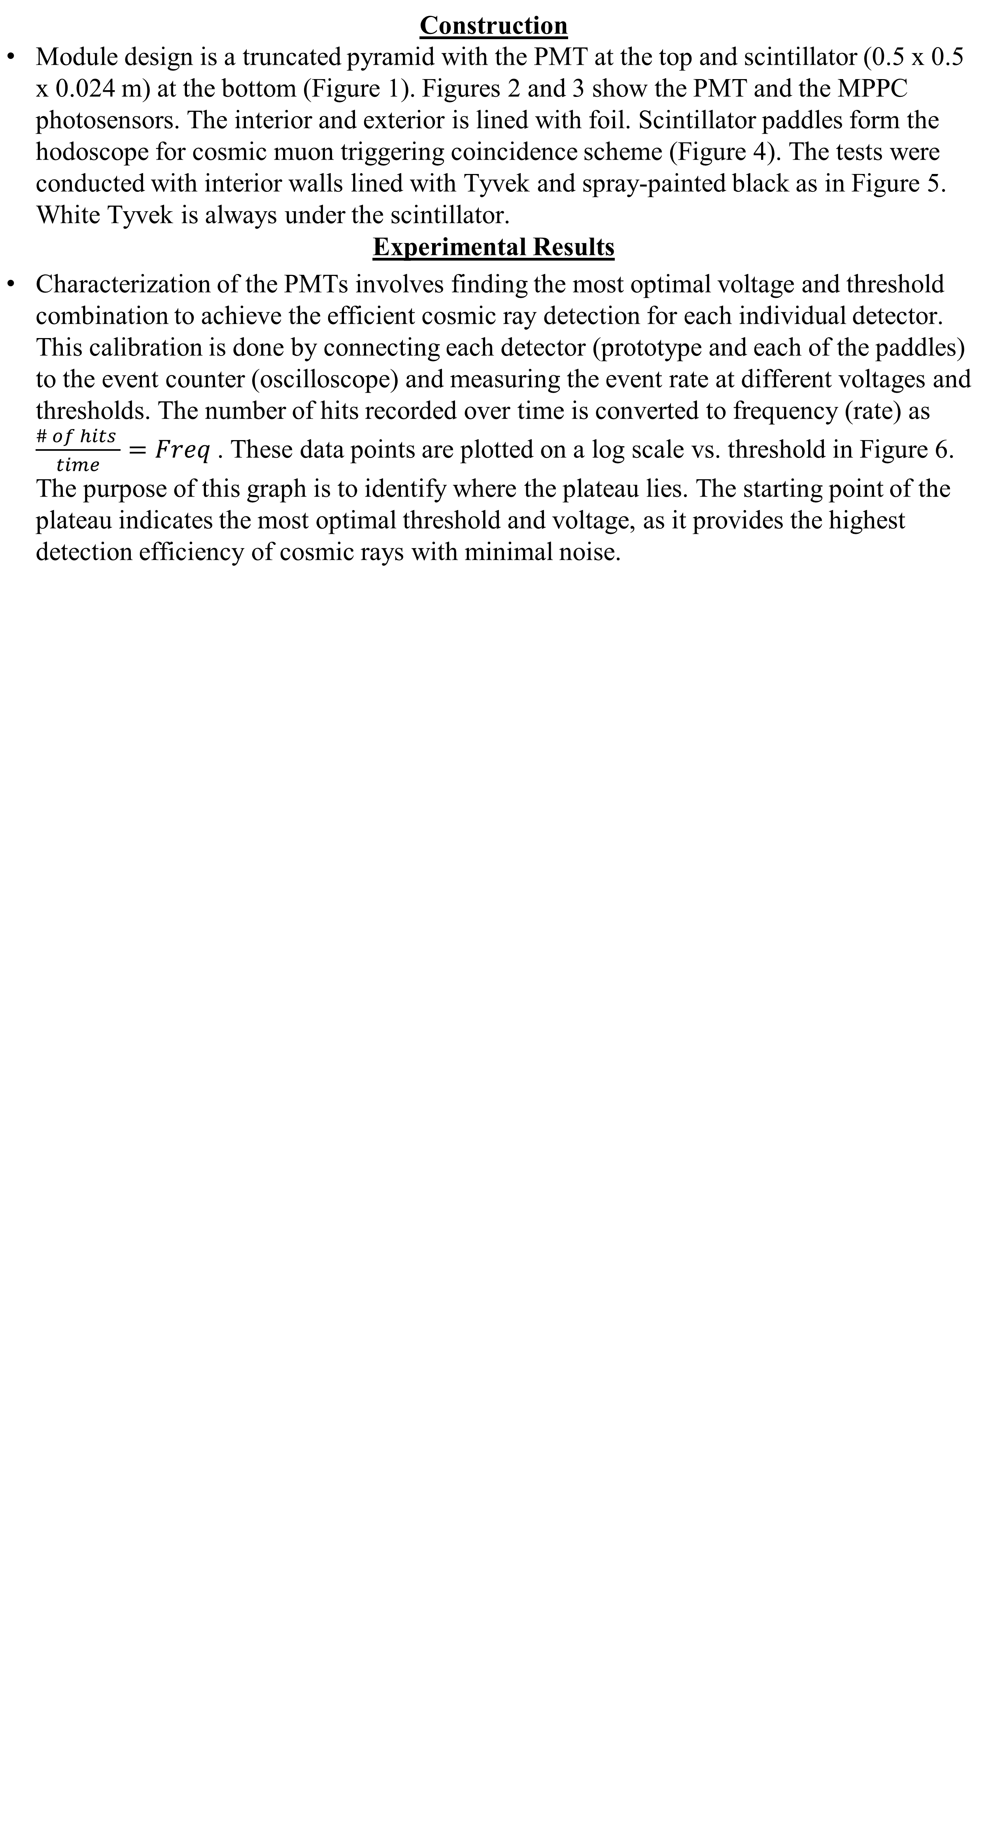
Design and Prototyping of the DUCK (Detector of Unusual Cosmic-ray casKades) March 27, 2024, CIMS SYMPOSIUM Dmitriy Beznosko, Shriya Chakraborti, Gerald Harris, Nicholas Muong*, Alexander Ramirez *presenter, muongn@student.clayton.edu
Introduction
One mystery currently being investigated in the field of High Energy Physics (HEP) is the origin and nature of Ultra-high Energy Cosmic Rays (UHECR). These cosmic rays, originating deep within the Universe, provide information from distant worlds and offer the possibility of uncovering new physics. The primary importance of the DUCK project lies in its novel approach to utilizing the full waveform and detector response width in the general Extensive Air Shower (EAS) event analysis methodology. It also provides independent verification of the detection of 'unusual' cosmic ray events by the Horizon-T detector system, potentially pointing towards new physics possibilities [1]. This poster details the current state of prototyping, designing, and optimizing the DUCK (Detector system for Unusual Cosmic ray casKades) prototype module, including PMTs (Photomultiplier Tube) and MIP (Minimally Ionizing Particle) calibrations at Clayton State University.
Construction Module design is a truncated pyramid with the PMT at the top and scintillator (0.5 x 0.5 x 0.024 m) at the bottom (Figure 1). Figures 2 and 3 show the PMT and the MPPC photosensors. The interior and exterior is lined with foil. Scintillator paddles form the hodoscope for cosmic muon triggering coincidence scheme (Figure 4). The tests were conducted with interior walls lined with Tyvek and spray-painted black as in Figure 5. White Tyvek is always under the scintillator. Experimental Results
Characterization of the PMTs involves finding the most optimal voltage and threshold combination to achieve the efficient cosmic ray detection for each individual detector. This calibration is done by connecting each detector (prototype and each of the paddles) to the event counter (oscilloscope) and measuring the event rate at different voltages and thresholds. The number of hits recorded over time is converted to frequency (rate) as $\frac{\# of hits }{time}=Freq$. These data points are plotted on a log scale vs. threshold in Figure 6. The purpose of this graph is to identify where the plateau lies. The starting point of the plateau indicates the most optimal threshold and voltage, as it provides the highest detection efficiency of cosmic rays with minimal noise.
PMT Calibration
The results from characterization of the prototype PMT are shown in Figure 6 The paddle PMTs were characterized similarly. MIP Signal Calibration Using cosmic muons and external trigger from paddles, the prototype signal is characterized. Tests are done with the detector housing walls lined with Tyvek and painted black. The Tyvek results are at the left in Figures 7, 8 and 9. The results for walls painted black are at the right in Figures 7, 8 and 9. Figure 7 shows the total area under the pulse from the PMT for the MIP passage through the scintillator. As expected, the Tyvek lining highly increases the total signal. However, this reduces the dynamic range of the detection. Figure 8 shows the peak width defined as time between the 10% of the total peak area to 50% of the area [3]. Due to multiple reflections in the detector, the Tyvek measurement yields much larger peak width. This suggests that painted walls must be used as the goal is to have the best time resolution possible. Value of 4.5 ns is consistent with the pulse width from paddles. Figure 9 shows the ‘full’ peak width defined as time between the 10% of the total peak area to 80% of the area [3]. Due to multiple reflections in the detector, the Tyvek measurement yields mush larger peak width. This suggests that painted walls must be used as the goal is to have the best time resolution possible. Value of 10.9 ns is consistent with the pulse width from paddles. As the MIP signal is too weak for reliable detection with walls pained black, thickness will be increased, and performance tested.
Experimental Setup
LV power supply
HV power supply
PMT
ADC
Function generator
Figure 2 : H11284-30 (former R7723) PMT from Hamamatsu [2]
MPPC
Scintillator
LED
Figure 1: General design of the DUCK detection module prototype. It includes the PMT and MPPC (Multi-Pixel Photon Counter) photodetectors, LED(Light Emitting Diode) and ADC (Analog-to-Digital Converter) with corresponding power supplies.
Figure 3 : MPPC from Hamamatsu [2]
Figure 6: Log of Frequencies vs Threshold for the Prototype DUCK PMT across various voltages to find optimal threshold values.
Paddle
Conclusion
In conclusion, the design and prototyping of the DUCK system have demonstrated a high likelihood of success for the final design. The prototyping phase has provided valuable insights into the necessary modifications required to enhance the efficiency of detecting Ultra-high Energy Cosmic Rays in the final design. These modifications have already been incorporated into the planning of the final version. Additionally, the data collected from the PMTs can be used to determine the most optimal thresholds and voltages for our data collection in the final design. Further plans The future of this research includes completing the characterization of the thicker scintillator performance, and to test the calibration capabilities using LED and MPPC sensor. Additionally, we aim to finalize the design elements of the prototype version of the DUCK. Completing this step will enable us to start construction of the final set of modules. Stability of the performance also needs to be accessed.
References
[1] Dmitriy Beznosko, Valeriy Aseykin, Alexander Dyshkant, Alexander Iakovlev, Oleg Krivosheev, Tatiana Krivosheev, Valeriy Zhukov, ‘Design Considerations of the DUCK Detector System’, Quantum Beam Sci. 2023, 7(1), 6; https://doi.org/10.3390/qubs7010006 [2] HAMAMATSU PHOTONICS K.K., Electron Tube Division, 314-5, Shimokanzo, Iwata City, Shizuoka Pref., 438-0193, Japan, http://www.hamamatsu.com [3] Dmitriy Beznosko, Valeriy Aseykin, Kanat Baigarin, Elena Beisembaeva, Turlan Sadykov, Marina Vildanova, Valery Zhukov. ‘Continuous detection points calibration at Horizon-T experiment and the status update’, 38th International Cosmic Ray Conference (ICRC2023), PoS(ICRC2023)195, DOI: https://doi.org/10.22323/1.444.0195, 2023/7/25
Figure 7: (left) Area of the MIP signal with white Tyvek sides. (right) Area of the MIP signal with painted black sides.
Paddle
Figure 4: (left) DUCK system prototype module connected to an oscilloscope and power supplies. The triggering paddles forming a hodoscope are at the top and bottom of the module. (right) Triggering paddles.
Figure 8: (left) ) 50% width of the MIP signal with white Tyvek sides. (right) ) 50% width of the MIP signal with painted black sides.
Figure 5: (left) Inside of the prototype with white Tyvek-covered side walls. (right) Prototype walls spray-painted black to reduce reflections.
Figure 9: (left) 80% width of the MIP signal with white Tyvek sides. (right) ) 80% width of the MIP signal with painted black sides.

